Slide 1
FlowinBlue
Counting whater matters.
Notes:
Product != App

Slide 2
How much energy do you use, for each min you shower?

Slide 3
20
CHARGES
* Based on calculation using US Environmental Protection Agency (EPA) data, assuming a warm shower
Notes:
Charge your phone 20 times over

Slide 4
35 €
3.467 l
in a year
saved yearly
101 kWh
avoided
If you shower 1 min less per day
Notes:
There are even products already based on this idea

Slide 5

FlowinBlue
helps you keeping track of the water consumption and saves money.

Slide 6
How it works
Get the App
Track your consumption
Compare and reduce
Download the app and start it before showering
Let the app count how long you have showered.
Look at your statistics and improve

Slide 7


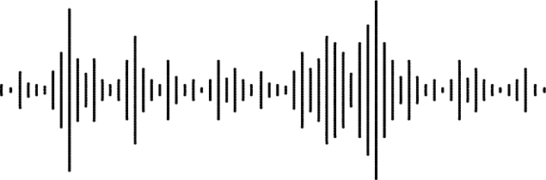
Start your App
Notes:
Taking audio signal and process it and detects the time spent with flowing water

Slide 8
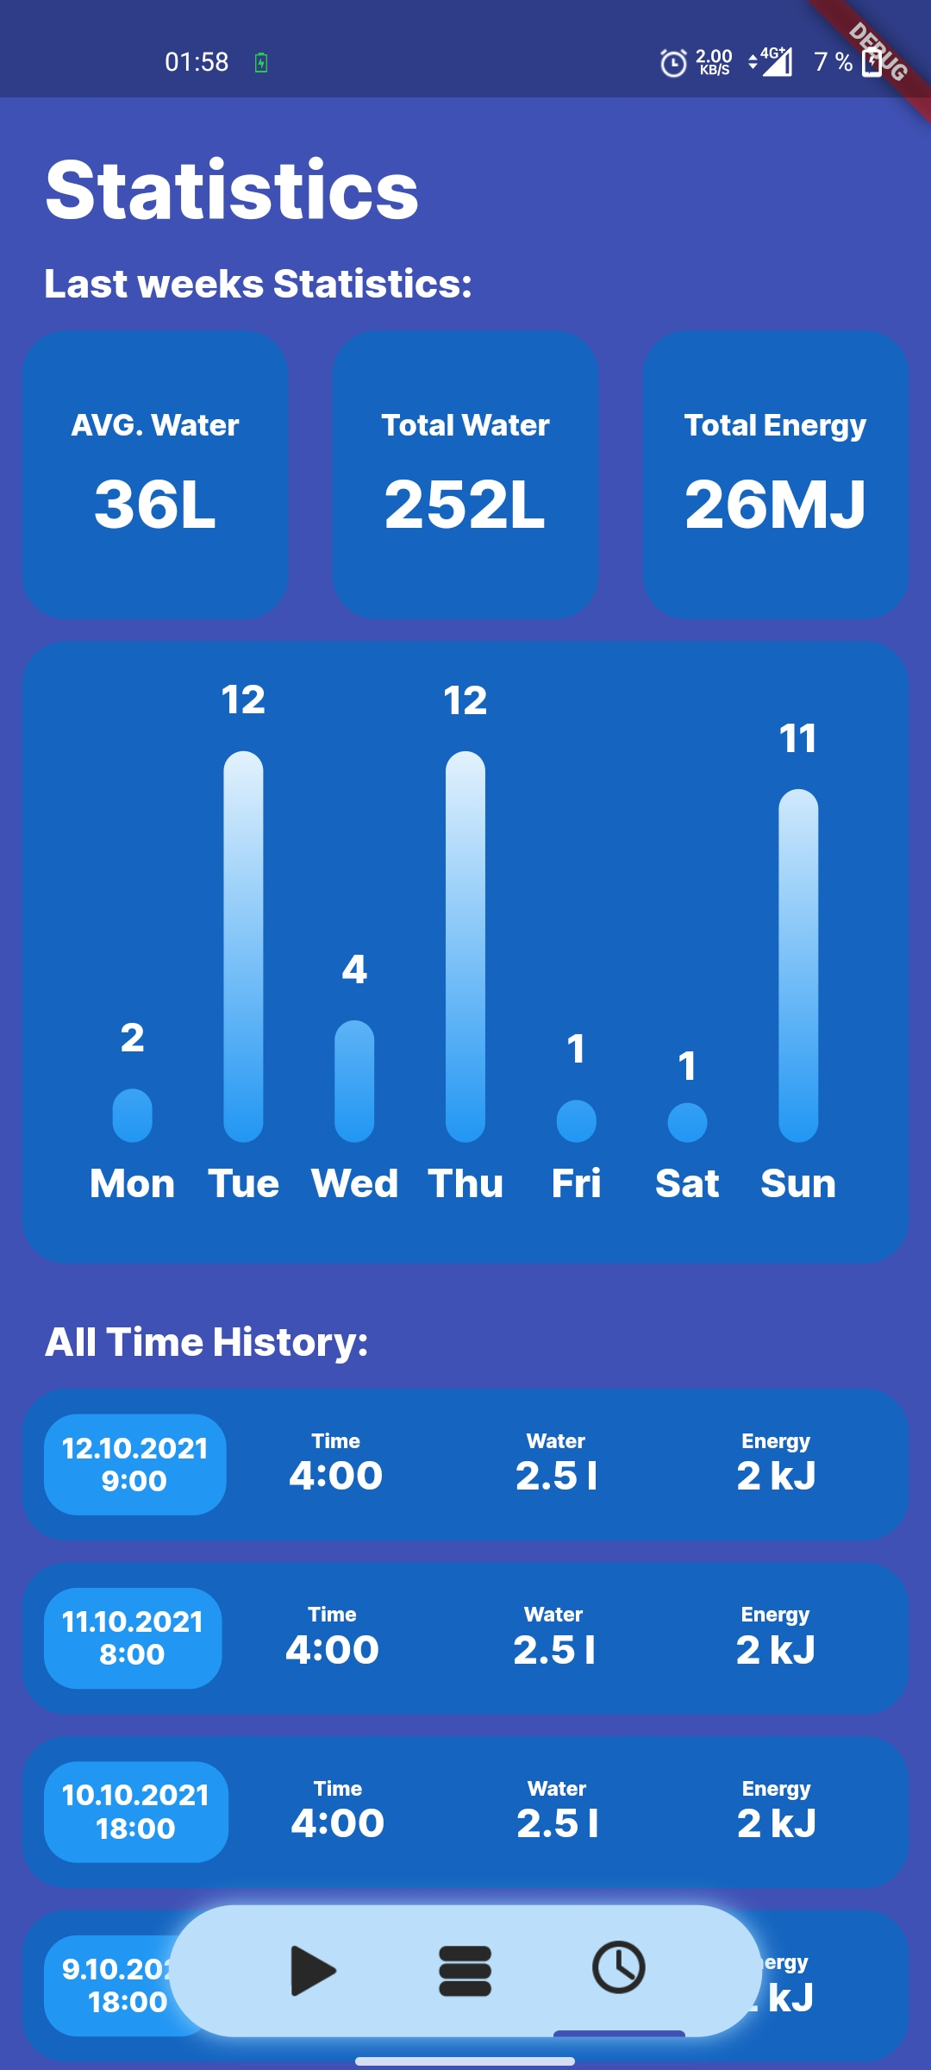
Check your consumption
Notes:
Explain the application interface

Slide 9
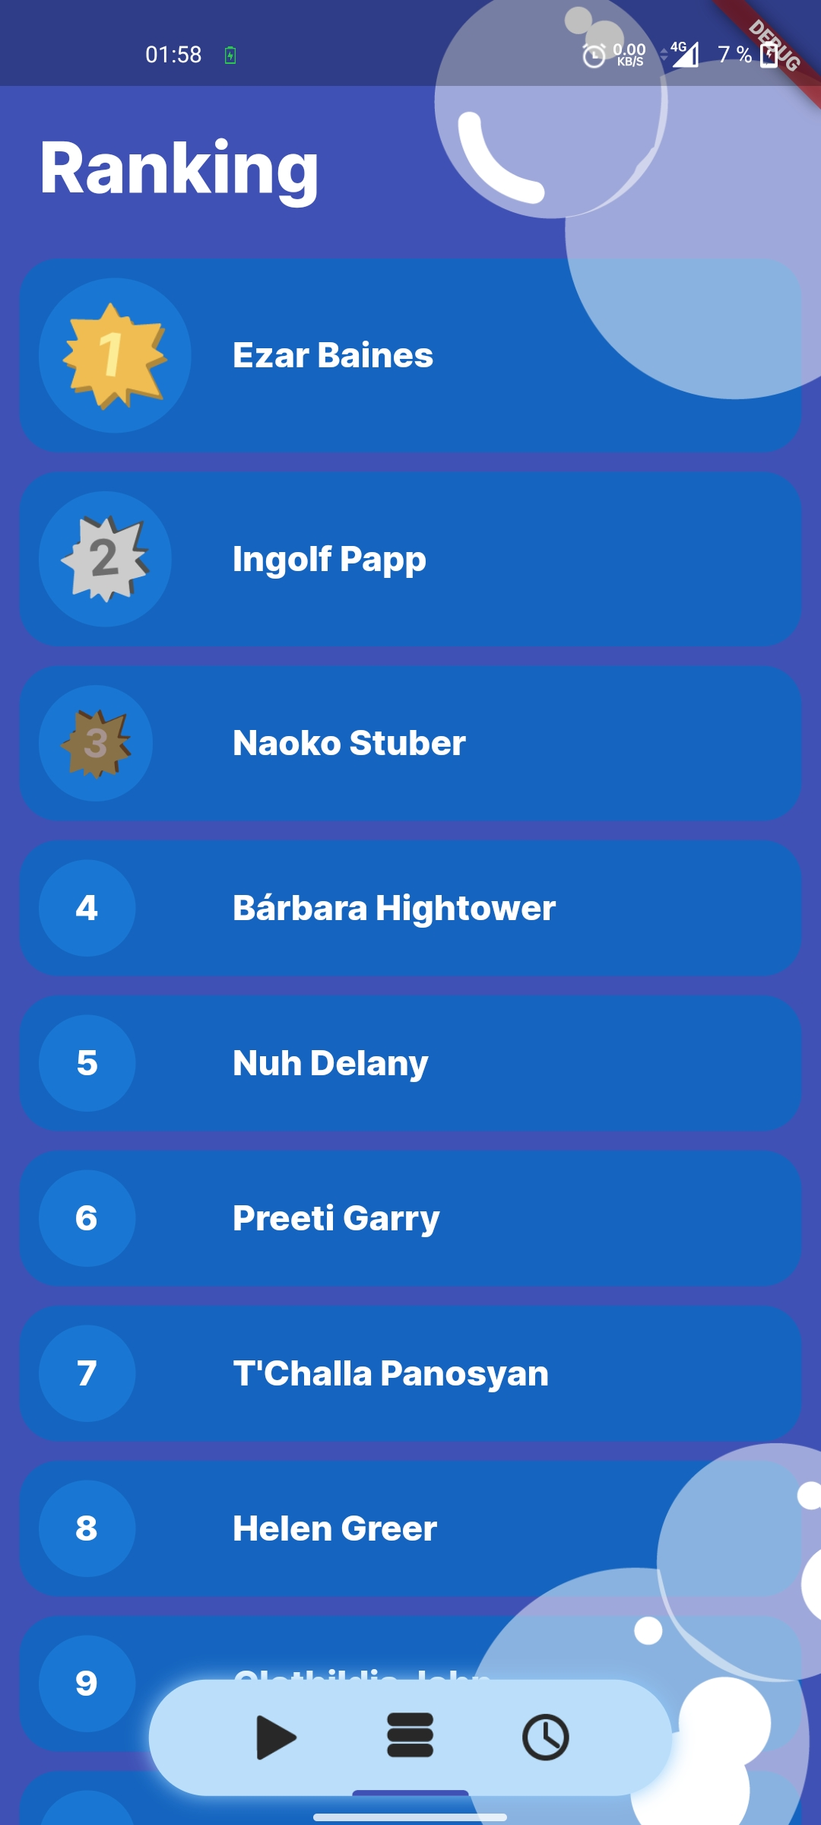
Share your progress with your friends
Notes:
Motivation to go further

Slide 10




The team behind the project
Alexander Hofmann
Dylan Alvandi
Mohamed Dhia Nouri
Paul Köhler
Data Analyst
Designer
Frontend Developer
Frontend Developer
Notes:
Our members have various backgrounds

Slide 11
What's next?
IMPROVE MODELS
REACH DEVICES
NEW DOMAINS
SUSTAINABLE WORLD
A lack of data resulted in a poor model. More data is required.
Move to all mobile platforms, web based service
and IoT
Include features like supermarket receipt scanning
Make the world more sustainable.
Step by step.
Notes:
Better estimates, higher accuracy
Water consumption from groceries

Slide 12
Thanks!
Do you have any questions?
FlowinBlue
]]

